Slide 1




Group 4
Ubaid SHEIKH (19154363)
Nusrat Laila (19060343)
Md Al Arman Khan (18897816)

Slide 2
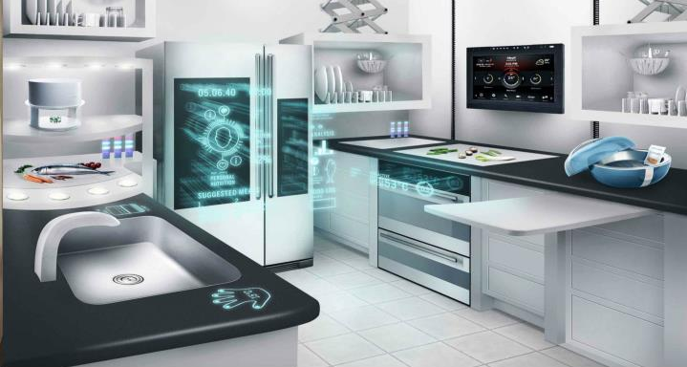
Outline of the Presentation
Project Description
Requirements
Used services
System Architecture
Cost analysis
Demonstration

Slide 3
Project Description
Tracking daily grocery consumption
Generating weekly grocery shopping list
Providing best price information for grocery shopping Comfort
Email notification to shop urgently if any item finished instantly
Email notification if any leakage found in the gas stove or gas cylinder and if the kitchen temperature is high. Safety
Tracking the daily resources (water, gas) consumption Sustainability

Slide 4
Used AWS Services

Slide 5
System Architecture

Slide 6
Cost Analysis
Table 1: Necessary estimation
Total number of household | 10000
Each household | 10 Sensors
User send GET request | 86 times a day
Table 2: Lambda Calculation
Monthly compute price per GB (MC) | $0.00001667
Running time | 1 second
Monthly Request price | $0.20 per 1 million requests
*Monthly Get update, Put things update and get shopping list functions = $84.77

Slide 7
Cost Analysis (Cont.)
Table 3: API Gateway Calculation
AWS API call charge | $3.5/ million
Data transfer charge | $0.09/GB
*If 10 sensors send update 4 times a day, Monthly Get request and Sensors update request= $136.42
Table 4: S3 Calculation
Total website (Smart Kitchen) file size | 9 MB
Total GET request | 26 million
Amazon S3 Service (Asia Pacific (Sydney)) = $11.43
Table 5: DynamoDB Calculation
Total database size for 10000 household | 1KB*100000/ 0.01GB
Number of Read request per month | 26 million
Write request per month | 12 million (why)
Amazon DynamoDB Service (Asia Pacific (Sydney)) = $7.05

Slide 8
Cost Analysis (Cont.)
Table 6: CloudWatch and SNS calculation
Number of CloudWatch and SNS request per month | 4 * 10000 = 40000
Amazon CloudWatch Service (Asia Pacific (Sydney)) | $0
Amazon SNS Service (Asia Pacific (Sydney)) | $0.78
Table 7: Total cost
Smart Kitchen whole project cost | Monthly | Yearly
Total service cost for 10000 households | $240.45 | $2885.4

Slide 9
Demonstration

